Slide 1
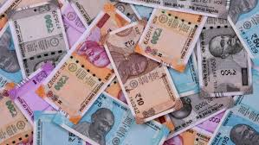
Machine Learning
Indian Denomination Classification
ccscsscs
Presentation by:
Aryan Tyagi (101816022)
Mehul Singh Teya (101816021)

Slide 2



Introduction
Our project classifies Indian denominations
Can classify Rs.10,Rs.20, Rs.100, Rs.200 (at present)
Based upon Deep Learning (CNN)
Written in Python 3.8
Implemented with TensorFlow, Keras, in Google Collaboratory

Slide 3
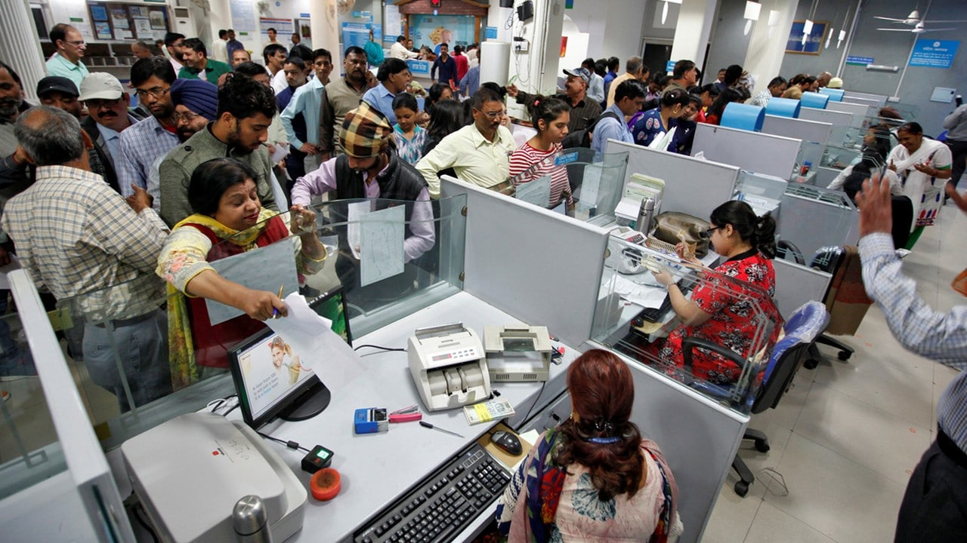
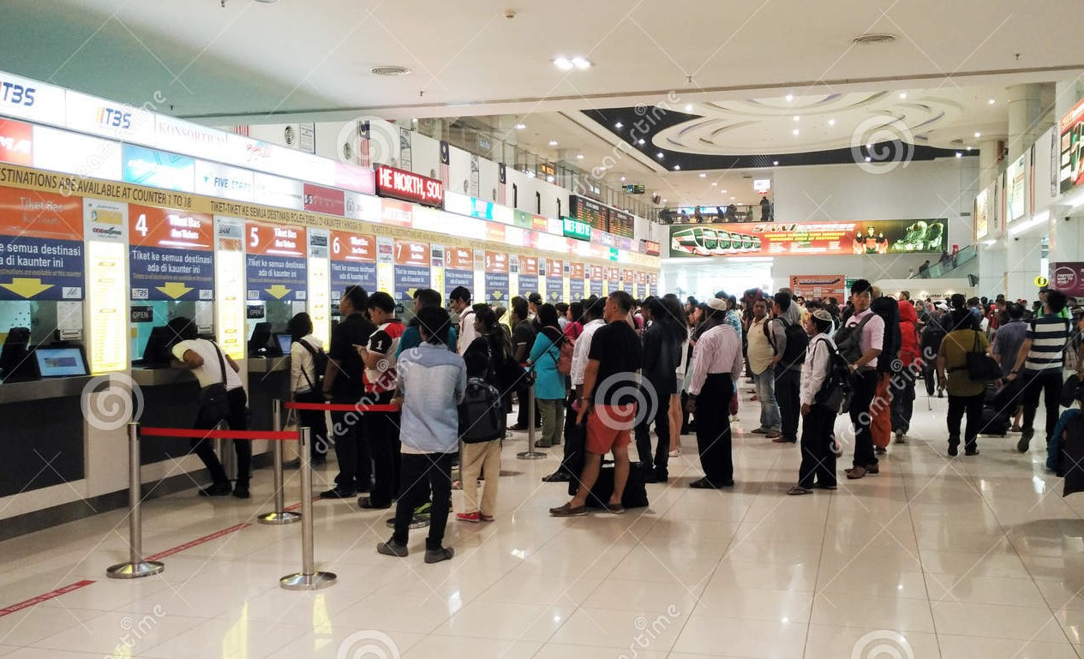
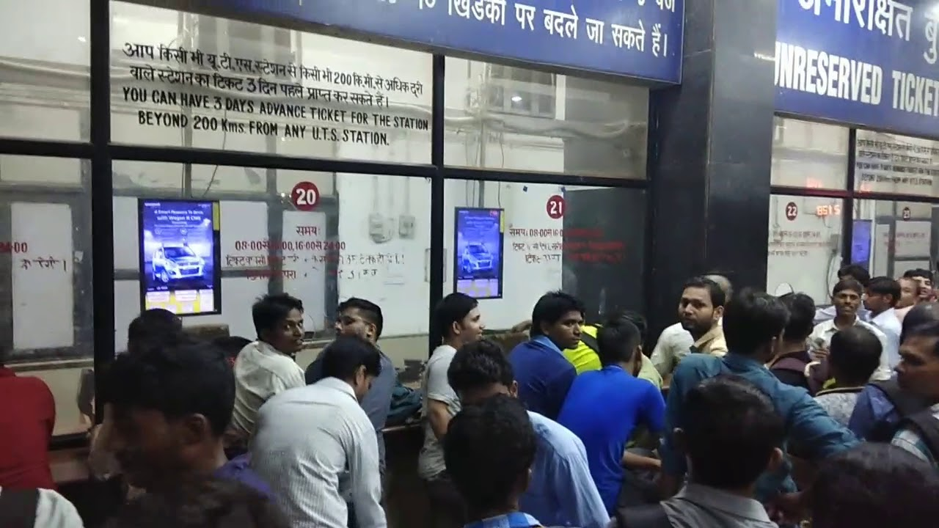
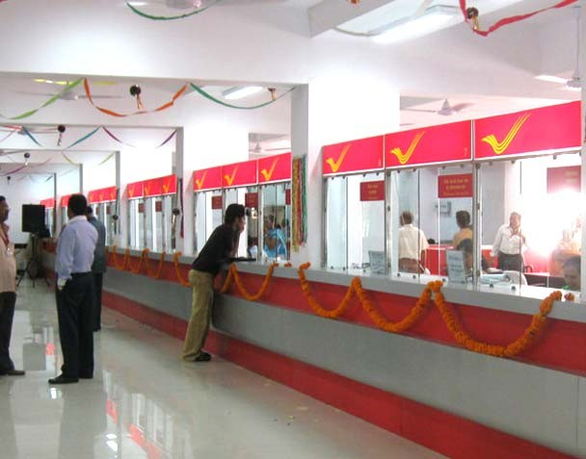
Goals
To reduce manual efforts, automate and digitalize
To help differently abled (blind) to verify notes
Can be used at places where, there is a hard cash transaction involved
Can be used at Banks, Post Offices, Bus Stations, Railways Stations etc.

Slide 4
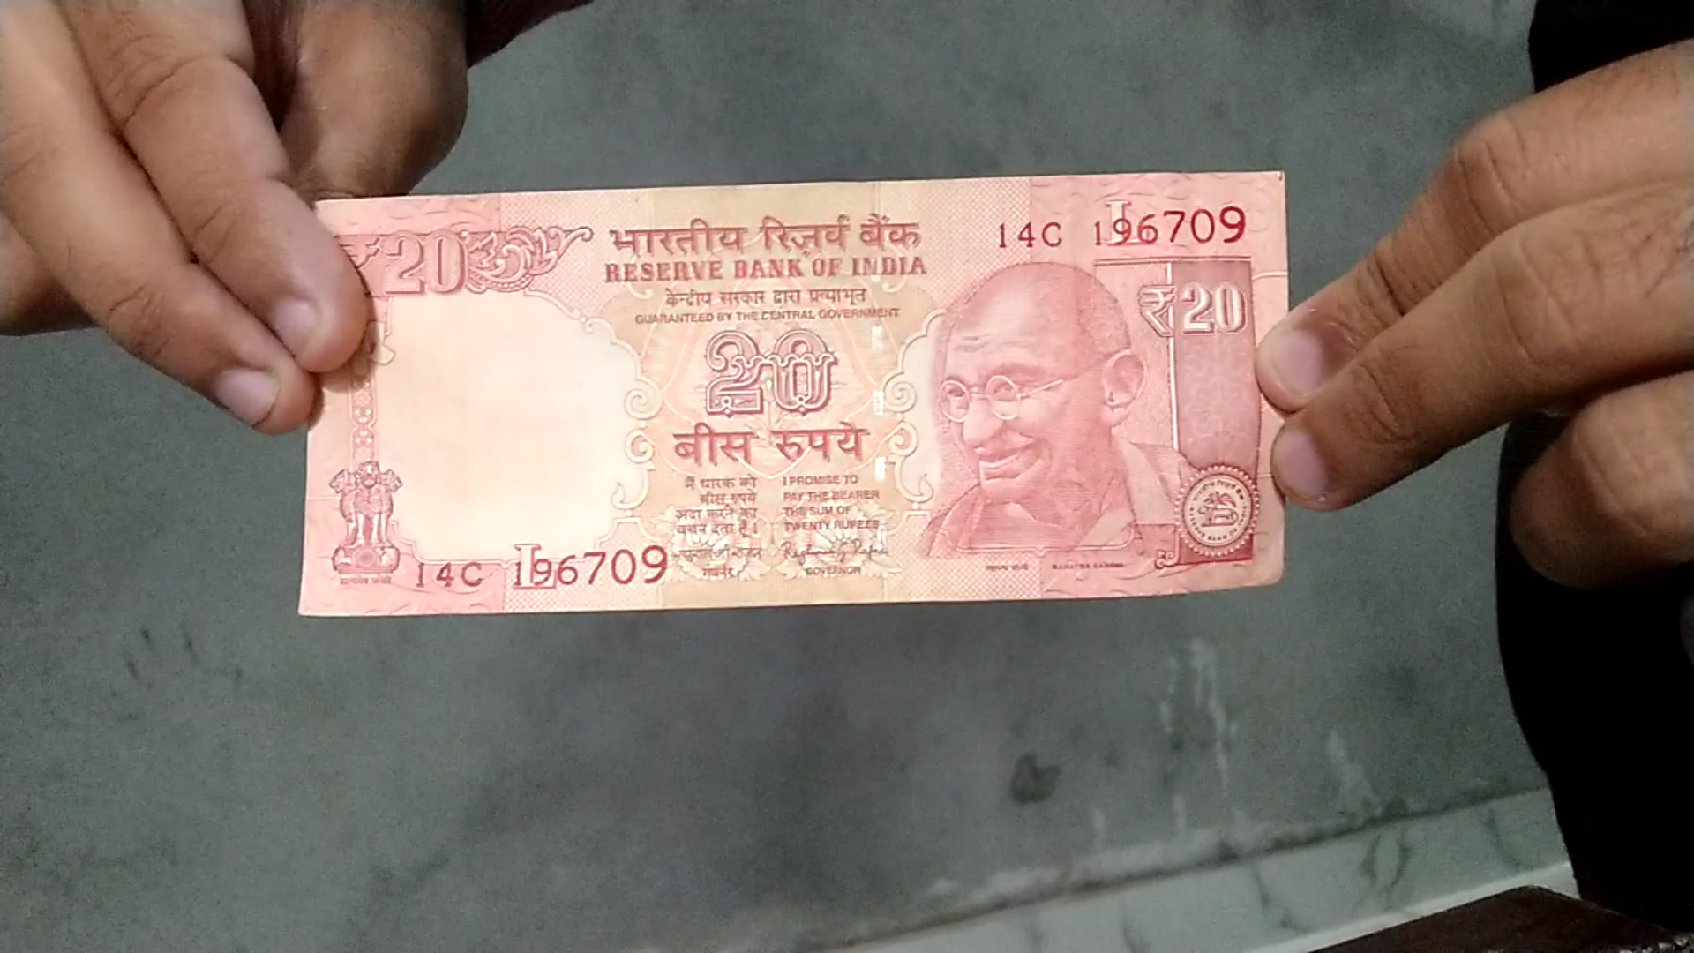
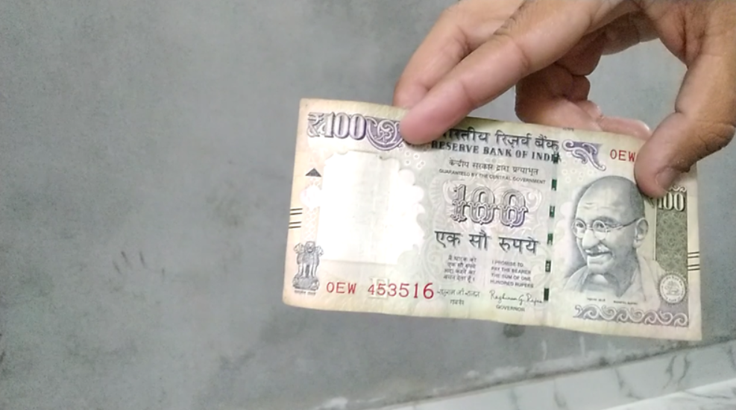
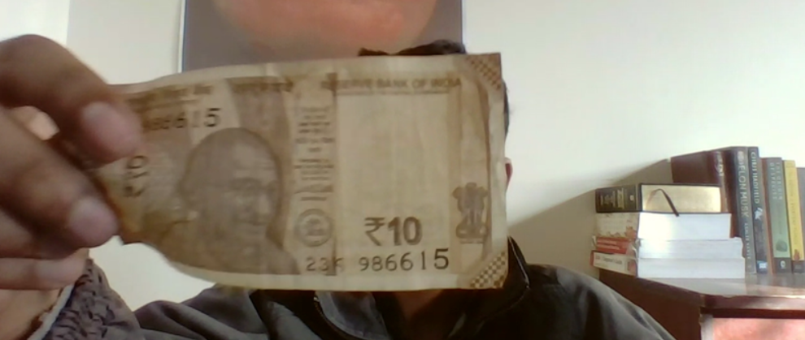
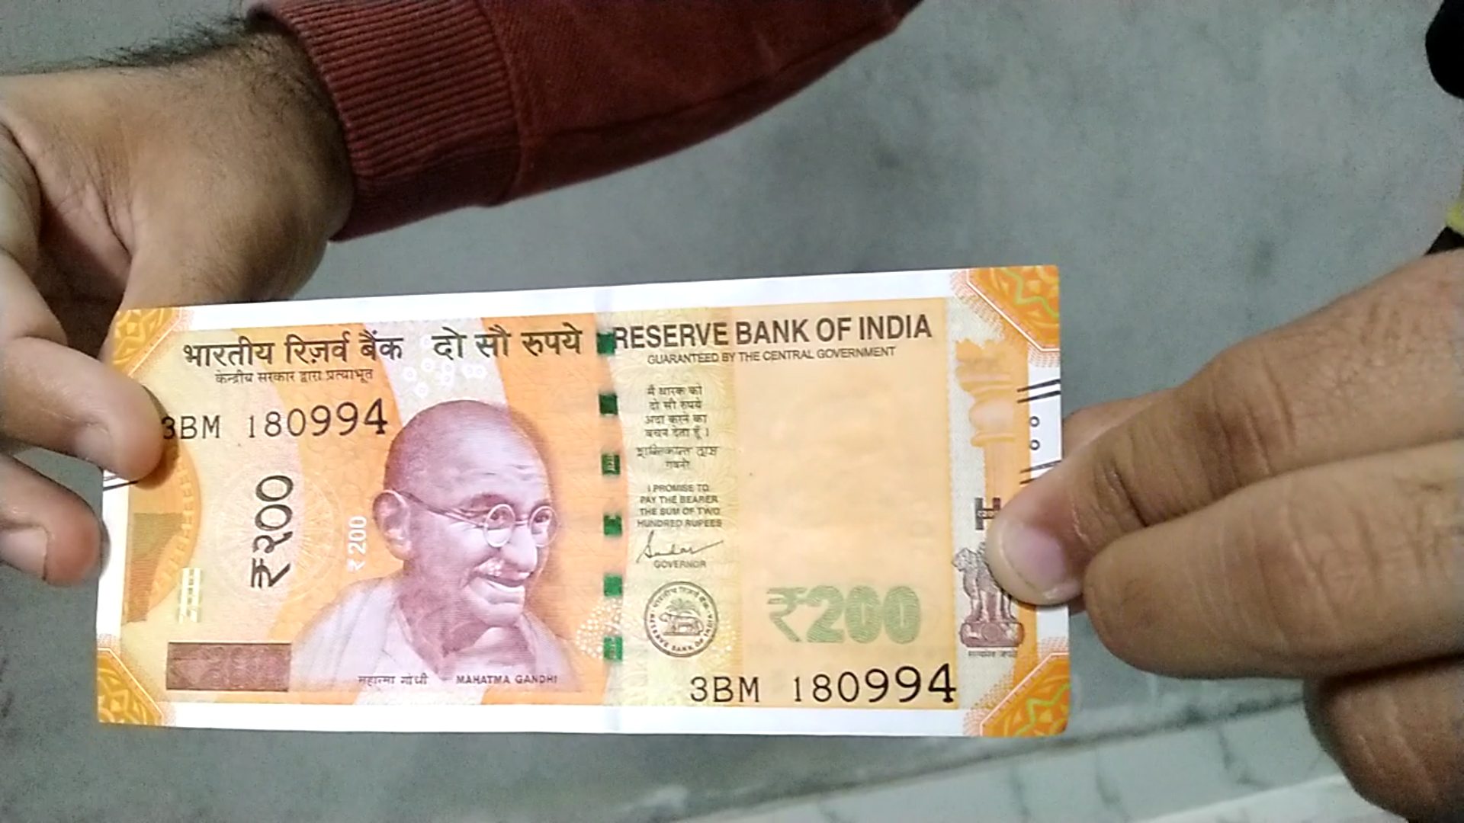
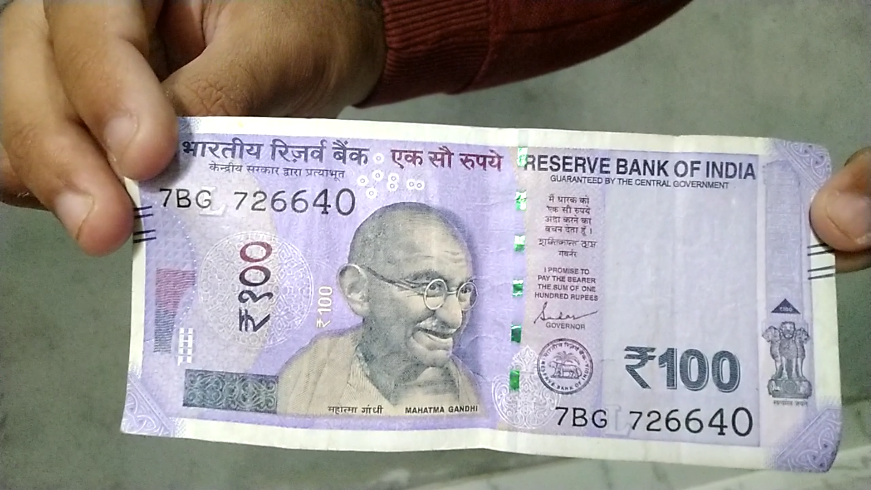
Dataset description
Our dataset consists of 556 different images, having 139 images in each category for Rs.10, Rs.20, Rs.100 & Rs.200 notes in different orientations & with variable backgrounds.
We also made our own videos and then extracted out frames from them

Slide 5
ML Techniques used
Deep Learning (Convolution Neural Networks)
Classification
Rescaling
Data Augmentation

Slide 6

CNN
Basically, CNN is ANN with some additional layers at the beginning, heavily inspired by the human brain, and are ideal for image classification

Slide 7

Classification
Like our brain works, CNN also tries to find features & tries to recognise the subject, irrespective of the location of the subject, background of the image.

Slide 8
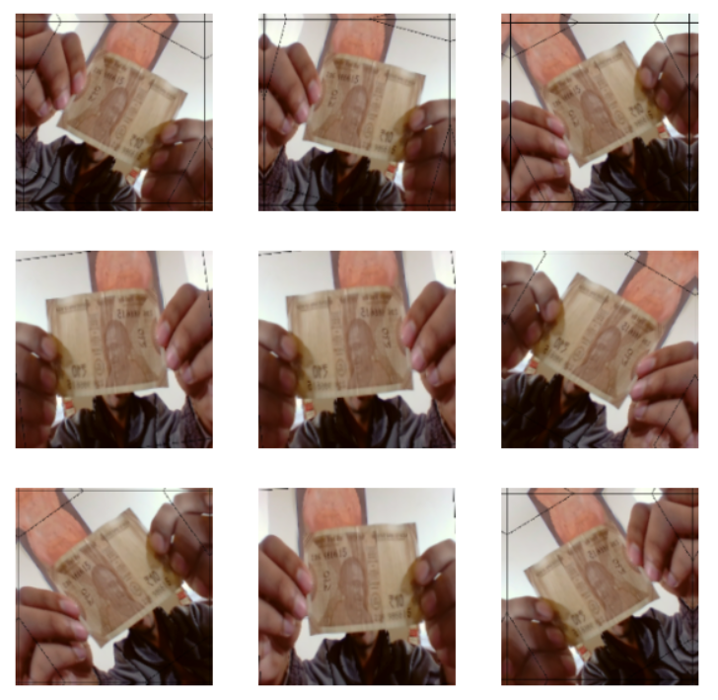
Data Augmentation
Data augmentation is a technique to artificially create new training data from existing training data.
Involves creating transformed versions of images in the training dataset that belong to the same class as the original image.
Transforms include a range of operations from the field of image manipulation, such as shifts, flips, zooms, and much more

Slide 9
Methodology
Data Collection & Data Pre-processing
Defined parameters for the loader, set batch_size, set image_size as 180x180
Split the dataset in 80-20 ratio for training and validation dataset
Then each class was represented properly, visualized the data using matplotlib.pyplot
The RGB channels were also standardized to fit in the [0, 1] range from the [0, 255] as neural networks prefer that range. This was done by using a Rescaling layer.

Slide 10
We then created a sequential model and used relu as the activation function
We used data augmentation to make up for the rather small size of our dataset
Then compiled the model, with optimizer set to ‘adam’ & loss function as ‘SparseCategoricalCrossentropy’
We then trained the model for 100 Epochs & then tested the model on new data
Finally, we saved the model using Keras for embedding it in our python script

Slide 11
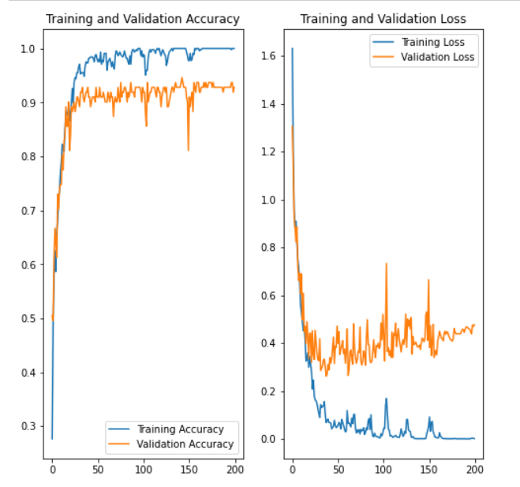
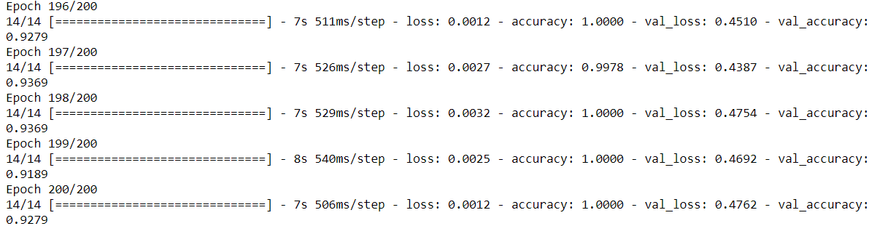
Results
S.No | Epochs | Accuracy
1 . | 200 | 92 .79 %
2 . | 100 | 87. 54 %
At 10 Epochs, we got 80%, on the testing set, then we realized that our dataset was small, so we applied data augmentation

Slide 12
Limitations
This system can’t read multiple notes in a single image. The image should only contain a single note of currency
Till now, it can not detect the location of the note in image. It only predicts amount of the note
It cannot detect multiple notes of same currency, of same denomination

Slide 13
Future Scope
We can make it self-learning, so that whenever anyone gives an image to our model, it only classifies the note, but also add that image into the dataset and get trained on it. So, it will keep on adapting and improving itself as we use it to predict.
We can extend it to any kind of currency with any number of classifications for denomination.
We can also install support with audio feedback, or turn it into a fully fledged software, to make it more interactive with the outer world. Audio feedback can help blind people to use this system.
We can also train this software detect any kind of cracks, or is the note is in whole shape or not.
With the help of object detection, we can also detect multiple notes in a single image, having same notes of single/multiple currency.

